Slide 1
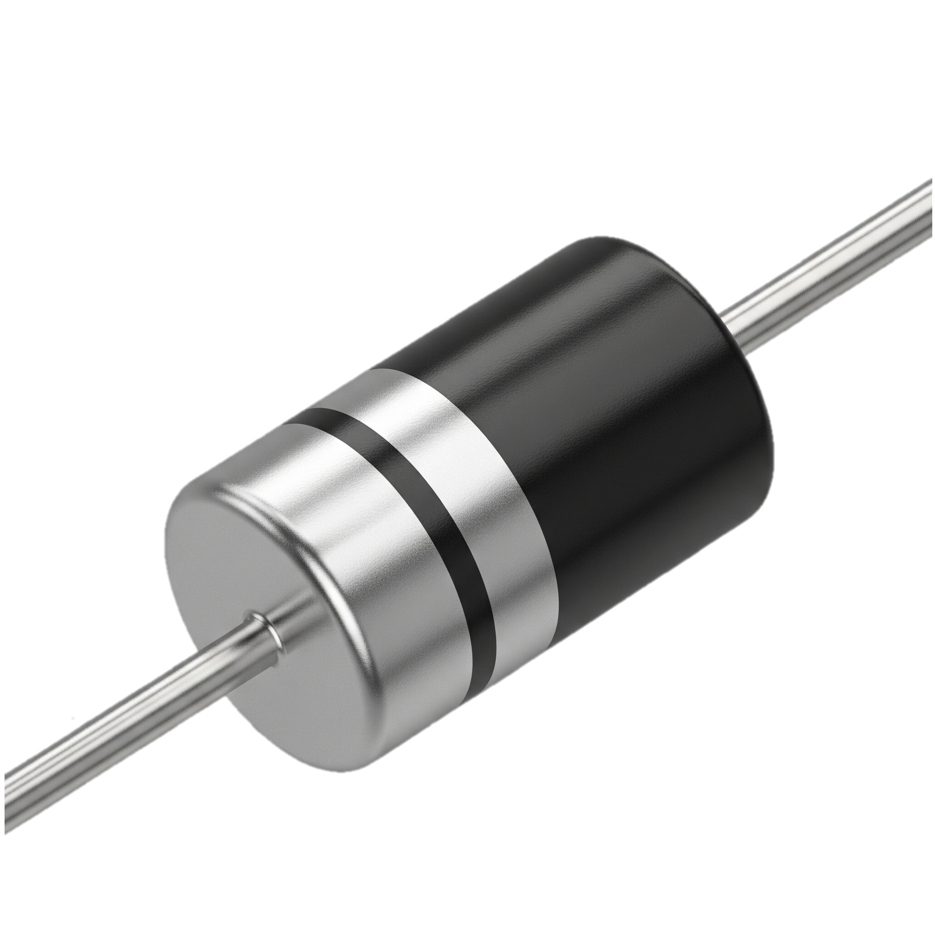
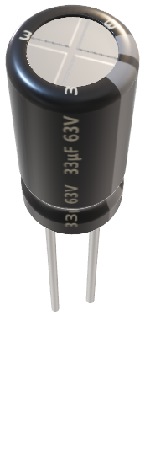
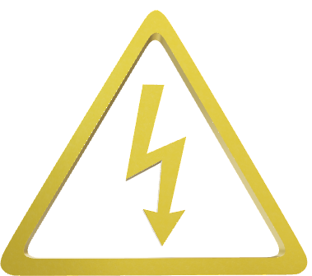
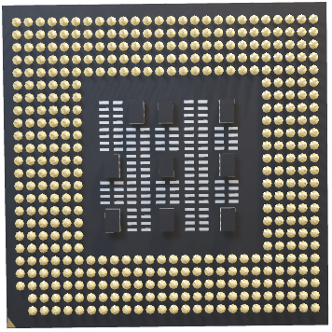
SEMICONDUCTOR AND MATERIAL SCIENCE
PRESENTED BY 11 TO 20

Slide 2
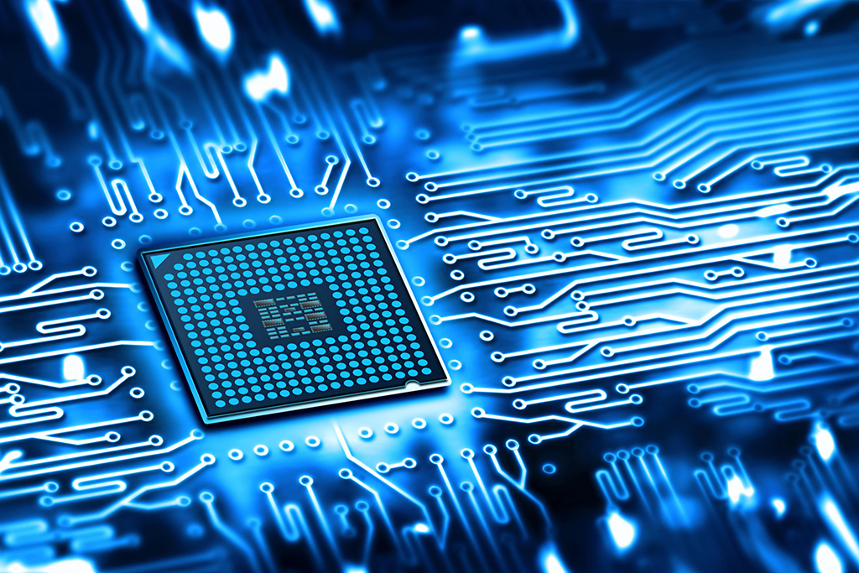
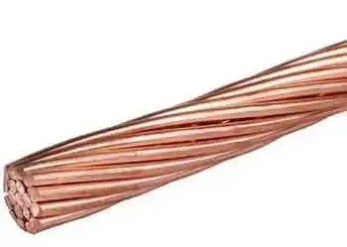

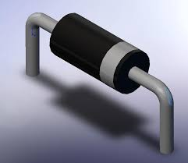
HOW ARE SEMICONDUCTORS ARE FORMED ?
Electron flow
Conductor
Insulators
Semiconductor
- Electrons rich
- uncontrolled flow
- Electron deficiency
- No flow of electron
Controlled flow Electron
Movement of Electron

Slide 3
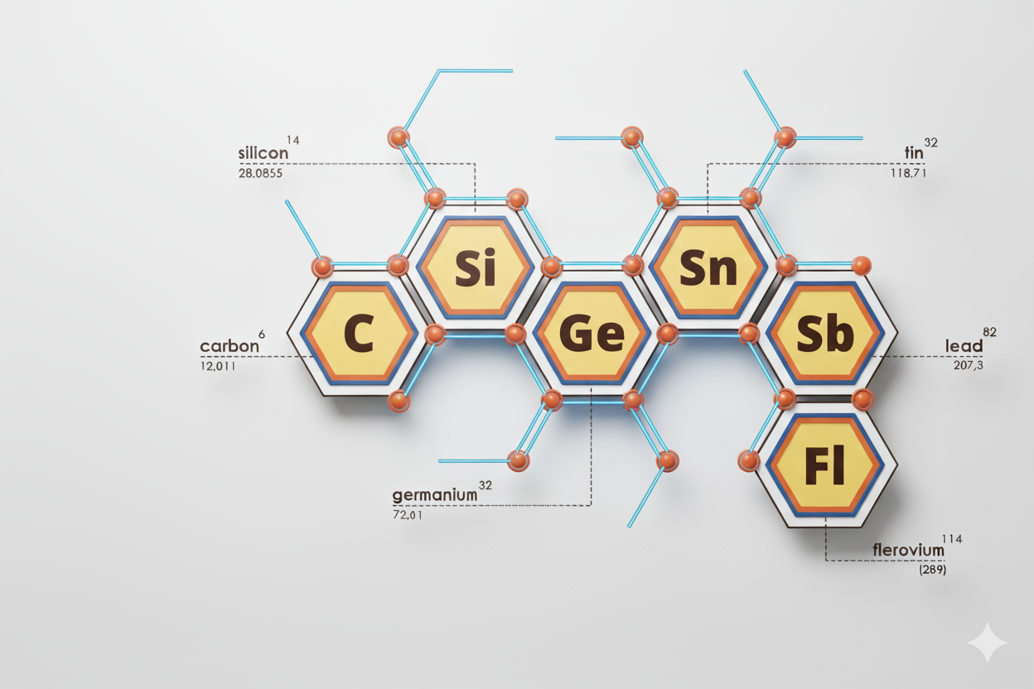
GROUP 14 ELEMENTS
Radioactive
Shows Allotropy
Decay
Conclusion: We can use only Silicon and Germanium

Slide 4
FORMATION OF SEMICONDUCTORS
How they are formed ?
Only group 14 elements are used here.
Each atom shares 4 valence electron with 4 neighbouring atoms.
Forming a strong covalent bond, i.e it creates a crystal lattice.
At absolute zero, no conduction.
With heat or light, some electrons break free, leaving holes.
Movement of electrons and holes allows the flow of current —----} This is semiconductor.
Two Types of semiconductors:
Intrinsic Semiconductor
Extrinsic Semiconductor

Slide 5
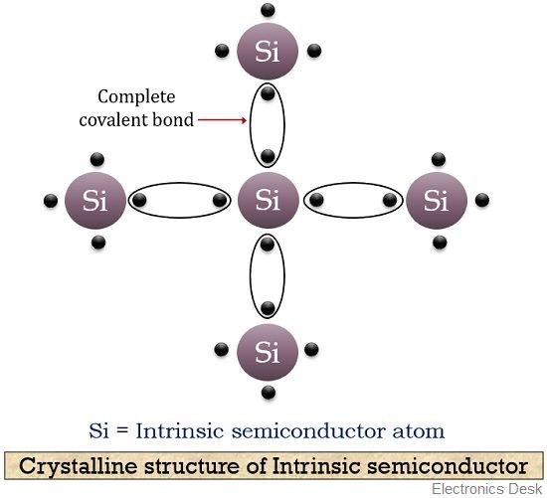
1. INTRINSIC SEMICONDUCTOR
A pure semiconductor is called intrinsic semiconductor.
Shearing of electrons to the same element due to this complete covalent bond.
Due to this it is stable
There for no control on semiconductor.
A pure crystals of Germanium and Silicon is an example of intrinsic semiconductor.

Slide 6
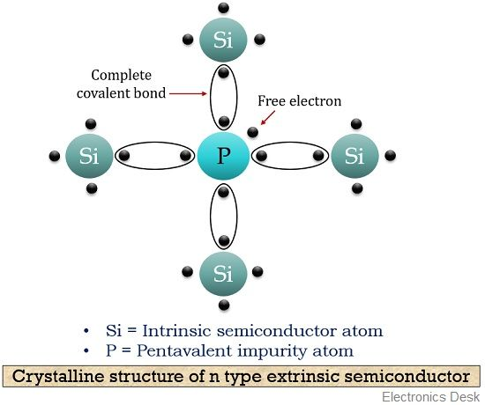
2.EXTRINSIC SEMICONDUCTOR
It is an impure semiconductor.
N-type: Formed by adding a pentavalent impurity, such as Phosphorus (P) or Arsenic (As), which contributes free electrons.
P-type: Formed by adding a trivalent impurity, such as Aluminum (Al) or Gallium (Ga), which creates a "hole" or an electron vacancy.

Slide 7
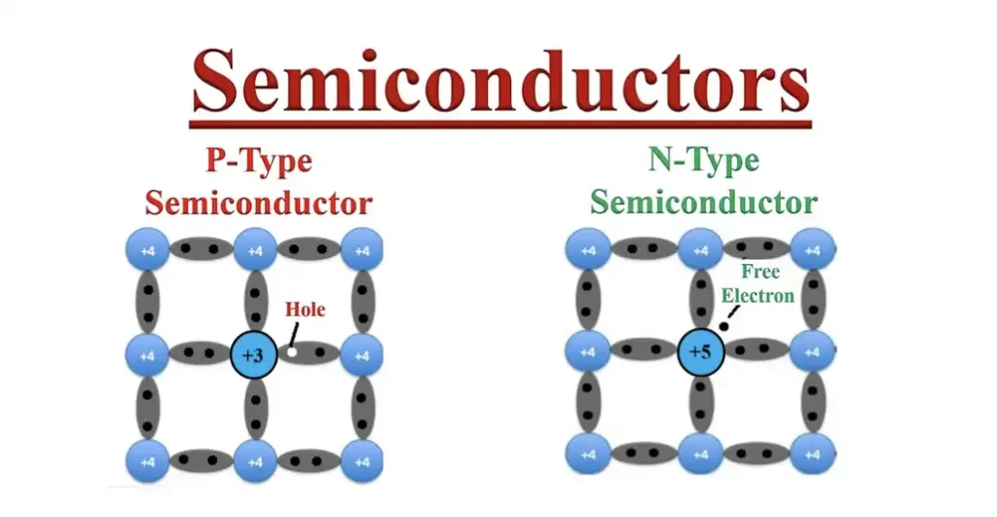
DOPING OF INTRINSIC SEMICONDUCTOR
Doping is addition of impure into intrinsic semiconductor.
We use Group 13 and Group 15 elements due to there same crystal structure.
Doping is use of control flow of electrons.
There are two types of Doping:
N-Type Doping.
P-Type Doping.

Slide 8
DIFFERENCE
P-Type Semiconductor
- Also known as Trivalent impunity.
Group 13 elements are use.
Due to gr.13 elements one holes are made.
Hole is also known as vacant spaces.
Due to hole electrons can
N-Type semiconductor
- Also known as Pentavalent impurity.
Group 15 elements are use.
Due to gr.15 elements one free electron are made.
Notes:
Aryan and Tejas

Slide 9
SUSTAINABILITY AND MANAGEMENT
Sustainability in Semiconductors:
* Raw Materials Use: Sustainable sourcing and efficient use of silicon, rare earth elements, and chemicals.
* Energy Consumption: Shift to renewable energy and energy-efficient designs,
* Waste & Pollution: Recycling chips and reducing toxic waste.
Notes:
Krushna

Slide 10


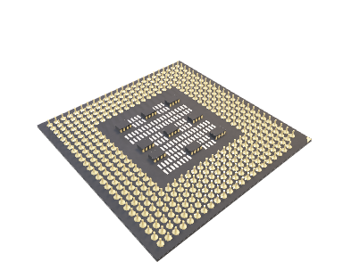
APPLICATIONS OF SEMICONDUCTORS
LED Lights.
Solar cells.
Mobile Devices.
Satellite Systems.
***
Notes:
Atharv Holkar

Slide 11
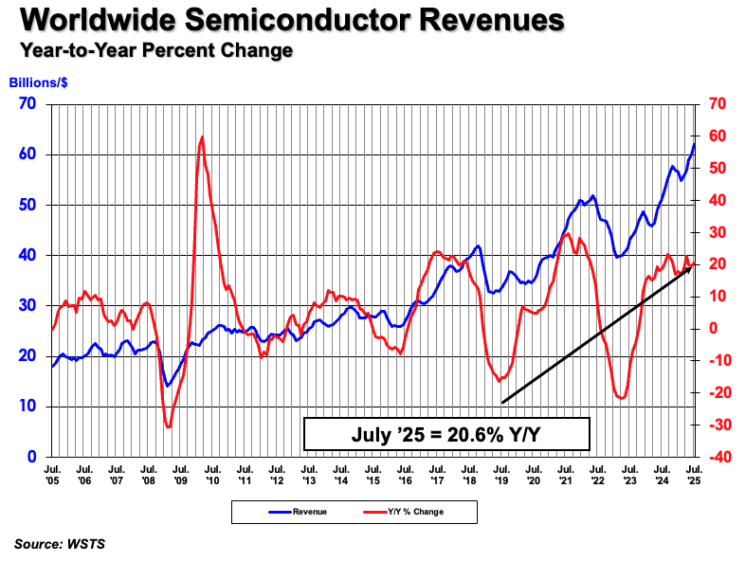
GLOBAL USE OF SEMICONDUCTOR
-Global Semiconductor-
Global Semiconductor Sales Increase 20.6% Year-to-Year in July.
-by Semiconductor Industry Association.

Slide 12
REFERENCE
Google
Wikipedia
Chat GPT
Google Gemini
SIA- Semiconductor industry Association.
Notes:
….

Slide 13
…
Thank you
***
Notes:
….

